Slide 1
MINI PROJECT ONLINE PHONEBOOK
BY-B HARIKUMARAN(RA2111004010416)
UDAY JAMI(RA2111004010417)

Slide 2
ABSTRACT
A few years back before internet people used telephone directory to get the telephone number of others
But with the help of today’s technology we came up with a small website called the phonebook
Basically the phonebook is a database where u can access the mobile number of anyone online
With the help of our project the user can not only access their phone number but also their other information such as address, email, gender etc

Slide 3
Features
Features of phonebook:-
Add data
View data
Modify data
Delete data
Searching of data

Slide 4
EXPLANATION AND FUNCTIONING
PHONEBOOK allows the user to search, add, edit, delete and modify their information
Phone book helps the user to access information like name , number, gender, father’s name, mother’s name, Citizenship number, address.
One of the advantages of phonebook is that it is easily accessible and also the data can be updated and can be modified as quickly as possible.

Slide 5
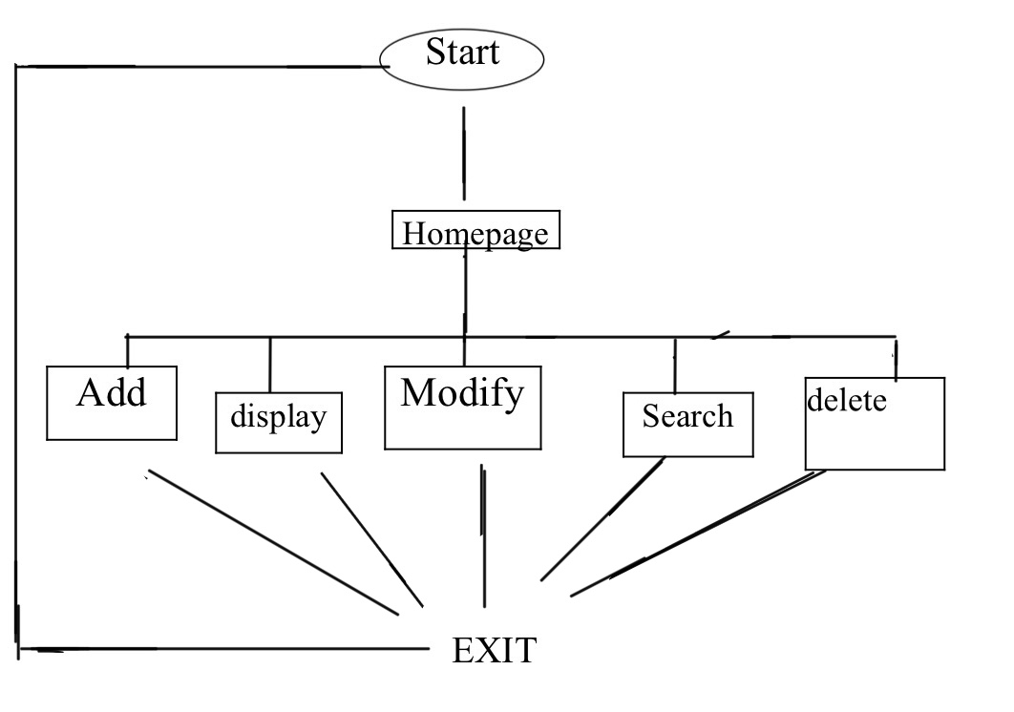
FLOWCHART

Slide 6
Code used
The language used for our project is C
Contents of our code:-
Data structure
File handling
Arrays
Strings
Basic concepts of functions

Slide 7
SOURCE CODE
https://github.com/hari-kumaran512/PHONEBOOK

Slide 8
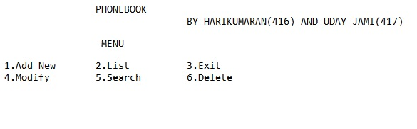
OUTPUT

Slide 9
THANK YOU

